Slide 1
SATURDAY APRIL 22ND - SATURDAY JUNE 3RD
Li'l Strikers Program

Slide 2
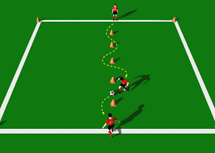
EACH WEEK PLEASE START OFF WITH THE DRILL OF DRIBBLING THROUGH THE CONES. EACH WEEK YOU WILL HAVE THIS DRILL AND 2 OTHERS TO TRY AND INCORPORATE INTO THE PRACTICE.
One time through using right foot, left foot, then both feet. Tell them to go slow! Learning to dribble is not about speed. Emphasize the goal is going around the cones.

Slide 3
WEEK 1 RED LIGHT GREEN LIGHT SET UP A 15×15 GRID FOR THE PLAYERS WITH CONES AND GIVE EVERY KID A BALL. THE GOAL HERE IS A LOT LIKE REGULAR RED LIGHT GREEN LIGHT, WHERE KIDS WORK ON THEIR LISTENING SKILLS AND FOLLOW DIRECTIONS, BUT IN THIS DRILL, THEY DO IT WHILE DRIBBLING AND AVOIDING OTHER PLAYERS. RLGL HELPS WITH DRIBBLING, FAST AND SLOW MOVEMENT CHANGES, AWARENESS OF THEIR SURROUNDINGS, AND FOCUS.
ONCE EVERYONE IS SET UP WITH THEIR BALL, EXPLAIN THAT THEY CANNOT LEAVE THE BIG SQUARE WITH THEIR BODIES OR BALLS, AND NO ONE CAN KICK ANOTHER PLAYER’S BALL.
TELL THEM THAT A ‘RED LIGHT’ MEANS STOPPING THE BALL BETWEEN THEIR FEET OR WITH 1 FOOT ON TOP.
START SLOWLY WITH THE USUAL RED, YELLOW, AND GREEN LIGHT COMMANDS. NO ONE GETS PUT ‘OUT,’ THOUGH. AS THEY GET THE HANG OF IT, SWITCH UP THE PACE SO COMMANDS COME FASTER OR THERE ARE LONGER DURATIONS.

Slide 4
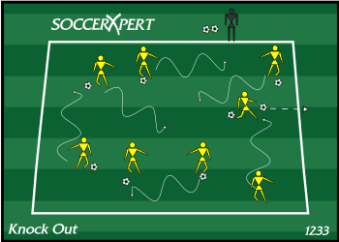
DRIBBLE TAG
You can set up a smaller field of play like a 20×20 box or use the whole field if you prefer for this drill.
However, 1/2 to 1/4 of the field is usually plenty. Every player gets a ball, and the goal is to get the most tags, but a player cannot tag another if they don’t have their ball. This exercise helps with dribbling.
Designate the boundaries of the field of play with cones.
Pass out balls, so every player has 1.
Explain to the kids that this is like tag, but you also have to dribble your ball while running.
Set a time limit and let them play.

Slide 5
WEEK 2 TAP MOVE TAP
Tap Move Tap
By using the inside of their feet, the players must kick their respective balls between both their feet. Start with slow movements and increase the speed of the drill as they get more and more comfortable with the game.
To increase the difficulty level, while they tap, move and tap, they can rotate clockwise and anti-clockwise while keeping the control over the ball steady. The players must try to maintain a tempo/ rhythm while kicking.

Slide 6
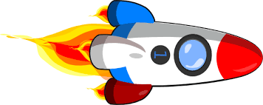
GUARD THE SPACESHIP
Create a box in front of the goal and call it the spaceship. The players must protect the spaceship by defending it from attack. Another set of players are the attackers. They try to blow up the spaceship by kicking at it while the defenders kick the balls away to save their ship.

Slide 7
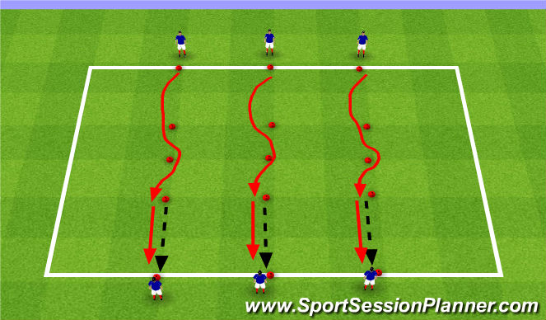
WEEK 3
Relay Cone Dribble
You’ll need several straight rows of cones and 1 ball per row.
Set your cones about a yard apart so the kids can work on their dribbling skills.
Divide team into even groups and have each player stand behind a row of cones.
On your signal, the 1st kid should dribble straight down the row to the end, turn with the ball, and come back down the other side.
At the end, they pass the ball to the next kid and so on until every player has gone.
The ‘winners’ are the team that finishes first.

Slide 8
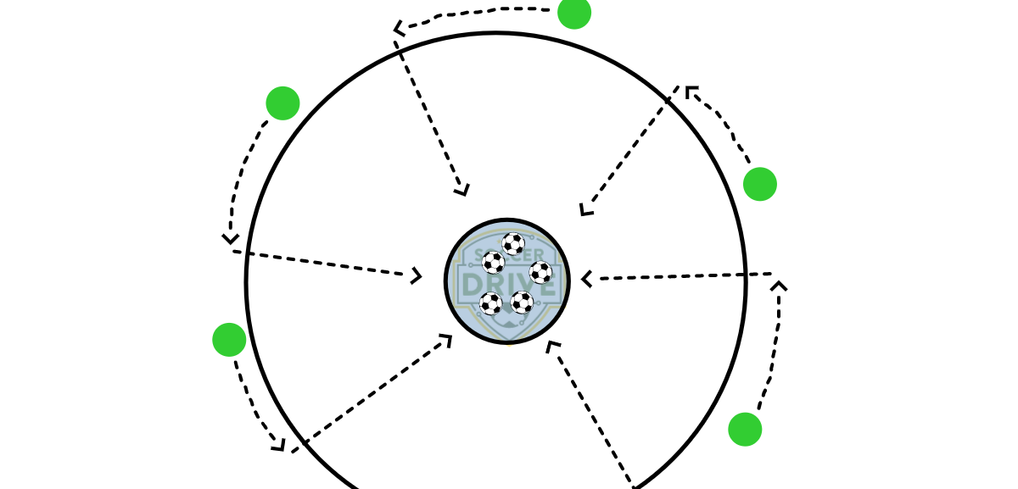
MUSICAL SOCCER
Place the soccer balls in the middle of the circle and make sure you have one less soccer ball than you have players. The players start on the outside of the circle and they are not allowed to go into the circle until the whistle blows. On the whistle, the players can sprint to the soccer balls. Because there is one less soccer ball, one player will be left without a ball. The player without the ball is then removed from the game and can then help the coach. Every round you will need to remove one soccer ball.

Slide 9
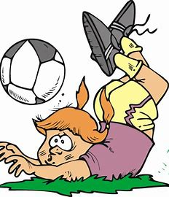
WEEK 4
Tag The Coach (With Your Ball)
This simple, fun game helps little kids start to work on their ball control and aim.
You set up a box with bonces big enough for the whole team to play inside and have some space to run around 20x20 or 30x30 should be fine. Then every kids gets a ball. The goal is to kick the ball towards the coach, but you can move around and dodge.
Once everyone is ready inside the box, explain they have to stay within the bounds and keep the balls inside the box. Keep rounds short, only 2-5 minutes.
Players can begin dribbling and shooting on your signal, but you should move around. Don’t go too fast. They aren’t that coordinated yet, but keep it challenging.
Any kid who gets the coach with their ball gets to name an animal and you have to make the sound of that animal.

Slide 10
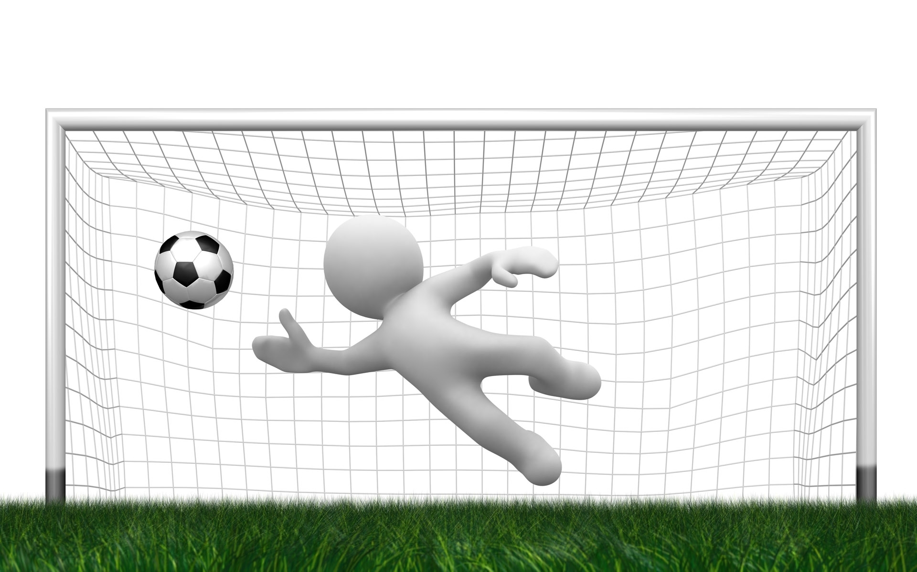
MINI GOALS
Mini-Goals is a 3-on-3 game where every team has a goalie and 2 players.
You need to set up mini fields only about 15 yards wide with 2 cones for a goal at each end.
Each group of 6 players is 2 teams, and they get 1 ball. You’ll need a whistle to start and stop the mini-games.
Rounds last 5 minutes, and then the players switch places until every player has been a goalie for 5 minutes, so your kindergarteners get to try out a simulated game and practice all their skills

Slide 11
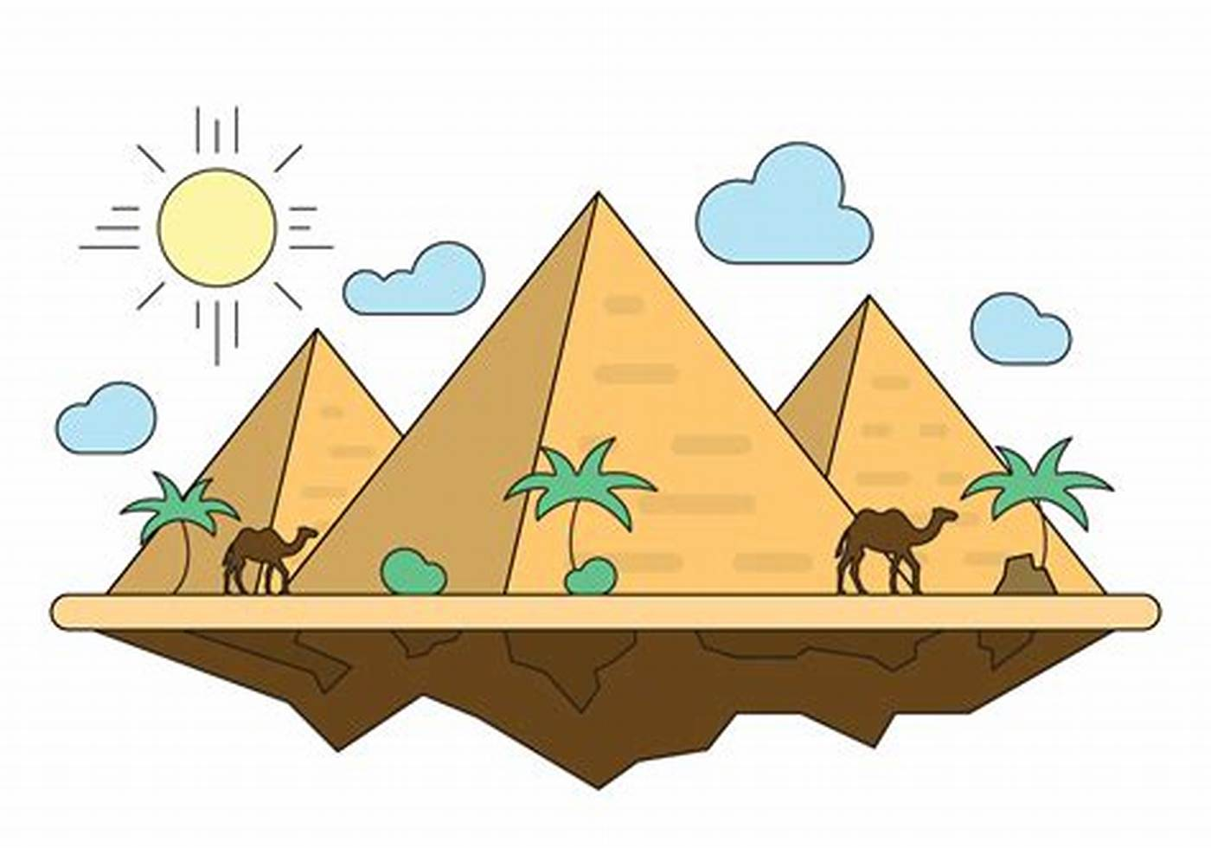
TRIANGLES
Triangles
This super simple passing game uses 3 cones, 3 kids, and 1 ball.
The only rule is that they have to pass the ball around the outside of the triangle. Separate the cones for longer kicks.
Split your team into groups of 3 and have each child stand behind 1 cone on a triangle.
Explain the rules and have them start on your mark.
Encourage kids to make their passes in 1 or 2 kicks.

Slide 12
WEEK 5
Pressure Passing
Mark a circle around one player and make others stand around it. Introduce a ball into the circle and let the player in the center kick it towards somebody in the outer circle.
The player outside must trap and kick it back towards the center. The player standing inside the circle must trap and kick the ball towards the next person in the outside circle this time.
After completing one circle, introduce another ball into the circus. Now the players must attend to two balls being passed around. Repeat until there are four balls in rotation.
Change the player inside the circle after every few minutes.

Slide 13
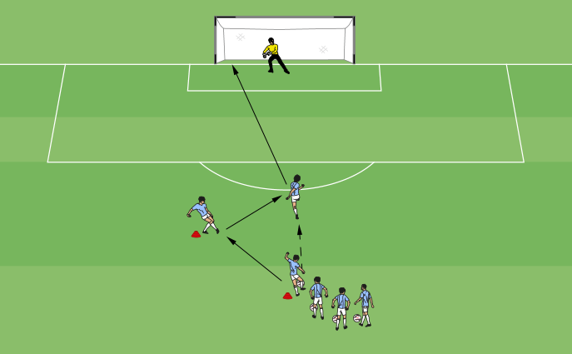
PASS, RUN, AND SHOOT
Pass, Run, And Shoot
Stand away from one player with the ball at your feet. Kick and pass the ball towards the kid but not directly to them. The kid must run towards the ball and kick it while it’s in motion and try to strike a goal.

Slide 14
WEEK 6 SHARKS AND MINNOWS
Sharks and Minnows
This drill trains young players to protect the ball by placing it between their bodies and the oncoming defender.
Set Up
Use markers to build a grid 20 by 25 yards. Feel free to adjust the size of the play area depending on the skill level and the number of players.
Two players stay in the middle of the grid without a ball. These are the sharks. The rest stand along the length of the grid, each with a ball at their feet. These are the minnows.
Objective
This drill aims to have the minnows attempt to dribble the ball across the sea of sharks to the other side of the dribble.
How to Play
At the coach’s cue, the minnows dribble the ball inside the grid and attempt to go past the sharks to cross to the other side.
The sharks attempt to steal the ball from the minnows.
Minnows who lose possession of the ball join the sharks. Minnows who successfully get to the opposite side attempt another round across the sea.
As you can imagine, the game becomes progressively harder as more sharks join the defined area.
The game ends after the predetermined time, for instance, 10 minutes or when only 1-2 minnows are left standing.

Slide 15
1V1 DEFENDING DRILL
Set Up
Use eight discs or cones to set up a small grid 2 yards by 8 yards.
Have two players start in the grid, one with a ball at his feet.
Objective
The goal of this drill is to teach defenders how to lead attackers into super tight areas with the least amount of space, for instance, along the sidelines. The drill also focuses on staying with the attacker by constantly switching their feet instead of turning around to chase them.
How to Play
The drill starts with the attacker and defender facing each other inside the grid. The attacker should utilize all skills learned to protect the ball from the defender. While the defender is not looking to steal the ball from the attacker, he wants to stay with them and force them into tight spaces. The goal is to choke the attacker. As the attacker changes direction, the defender should stay with them by shuffling their feet to minimize available space.

Slide 16
HELPFUL HINTS:
Always start with a quick warm up with the players in a line or a circle around the coaches. The more spread out the players, the better they will pay attention to you and not a friend standing next to them.
Use the phrase “Stay Away” instead of “Spread Out.” We have all seen young players of all ages congregate around whoever has a ball. The term “Stay Away” is more emphatic of the need for the player without the ball to move away and will naturally be in open space.
Set the precedent that whenever a coach is talking, no one else should be talking or kicking the ball around. It is helpful to have a rule requiring the ball be in front of the players feet and still.
Always use positive language and focus on the positive before giving any feedback for change.
Explain what the drills are, but don’t over emphasize the reason for the drills. Let is just be fun for the kids.
When players are moving through the cones encourage them to use both feet.
Always be consistent with what you are telling the players.
Try to not Shoot on goal without any passing and/or cones.
Keep it fun!

Slide 17
RESOURCES USED FOR POWER POINT AND HELPFUL WEBSITES.
Soccer Drills For Kindergarten: (Top 10) – Fun In The Yard
https://www.soccercoachingpro.com/soccer-dribbling-drills/
https://www.soccercoachweekly.net/drills-and-games
https://www.usyouthsoccer.org/first-time-coaches/
17 Best Soccer Drills For 3 and 4-Year-Olds [2023 Guide] (thechamplair.com)
https://www.sportsessionplanner.com/

